Slide 1

TITLE
PERSONAL FINANCE CHATBOT: Intelligent Guidance for
Savings , Taxes and Investments

Slide 2
INTRODUCTION
The personal Finance Chatbot is an AI-powered virtual assistant designed to help individuals manage their money effectively. It uses natural language processing to interact with users in a simple, conversational way. The chatbot assists with management, loan, and EMI calculations, and provides basic investment insights. Built using python, IBM Watson, and Hugging Face models, the chatbot is secure, scalable, and accessible anytime. By combining financial literacy with artificial intelligence, the personal finance chatbot act as a smart, always-available financial advisor, making money management simple and personalized.

Slide 3
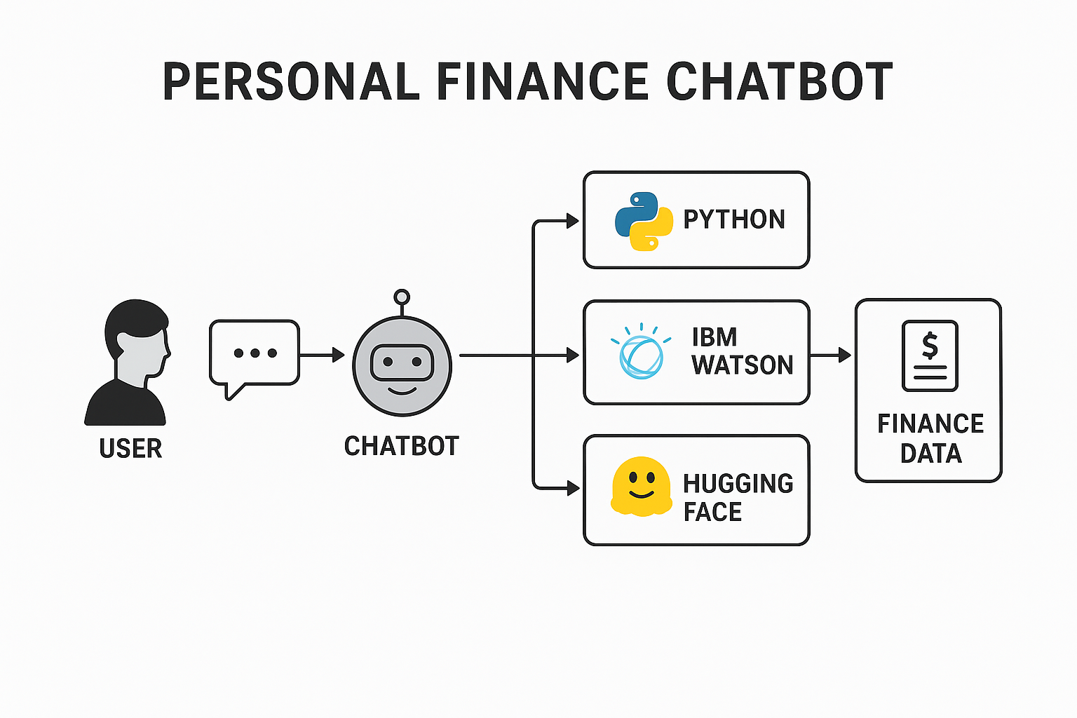
ARCHITECTURE

Slide 4
FUTURE SCOPE
The future scope of the Personal Finance Chatbot lies in its potential to evolve into a comprehensive financial management assistant that not only provides insights but also automates decision-making. With advancements in machine learning and predictive analytics, the chatbot can be enhanced to forecast expenses, recommend personalized investment portfolios, and identify potential risks in financial planning. Integration with real-time financial data sources such as stock markets, tax portals, and banking APIs will enable the chatbot to deliver up-to-date, actionable insights for better savings, tax planning, and investment decisions.

Slide 5
SOLUTION
The solution for the Personal Finance Chatbot project is to design and implement an AI-driven conversational assistant that integrates natural language processing (NLP) with financial knowledge bases to guide users in managing their money. Using Python as the core programming language, the chatbot can leverage IBM Watson for robust NLP capabilities and Hugging Face models for advanced intent recognition and contextual understanding. The system will be connected to a secure backend that stores user profiles, financial data, and preferences, enabling the chatbot to provide tailored advice on savings, tax planning, loans, EMI calculations, and basic investment opportunities.
To ensure scalability and reliability, the solution involves deploying the chatbot on cloud infrastructure with encrypted data handling for user privacy. By combining AI-powered conversation, financial rules, and real-time data integration, the chatbot will serve as an accessible, 24/7 financial advisor. This approach not only simplifies complex financial decisions but also promotes financial literacy and independence, making money management more efficient and personalized for every user.

Slide 6
CONCLUSION
Personal Finance Chatbot = Smart, Simple & Secure money manager. Empowers students & professionals to make better financial decisions. In conclusion, the Personal Finance Chatbot represents a powerful blend of financial literacy and artificial intelligence, offering users a simple yet effective way to manage their finances. By leveraging Python, IBM Watson, and Hugging Face models, the chatbot ensures intelligent, secure, and personalized interactions, enabling users to perform tasks such as loan and EMI calculations, savings management, and receiving basic investment insights. Its conversational nature makes financial planning more approachable, helping individuals take informed decisions without needing in-depth financial expertise.

Slide 7
THANK YOU

